Slide 1

Cloud Application Architecture Styles
Session 01

Slide 2
AGENDA
Architecture styles
N-tier
Web-Queue-Worker
Microservices
Event-driven
Data architecture
Compute architecture
Architecture styles as constraints

Slide 3
Objectives
This session presents a structured approach for designing and architecting applications on Azure that are scalable, secure, resilient, and highly available.
It is based on proven practices that we have learned from customer engagements.

Slide 4
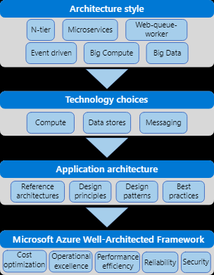
How this session is structured
Etc.
Notes:
The Azure Application Architecture Guide is organized as a series of steps, from the architecture and design to implementation. For each step, there is supporting guidance that will help you with the design of your application architecture.

Slide 5
Architecture Styles
An architecture style is a family of architectures that share certain characteristics.
Architecture styles don't require the use of particular technologies, but some technologies are well-suited for certain architectures.

Slide 6
N-tier
N-tier is a traditional architecture for enterprise applications.
Dependencies are managed by dividing the application into layers that perform logical functions, such as presentation, business logic, and data access.
N-tier is a natural fit for migrating existing applications that already use a layered architecture. For that reason, N-tier is most often seen in infrastructure as a service (IaaS) solutions, or application that use a mix of IaaS and managed services.

Slide 7
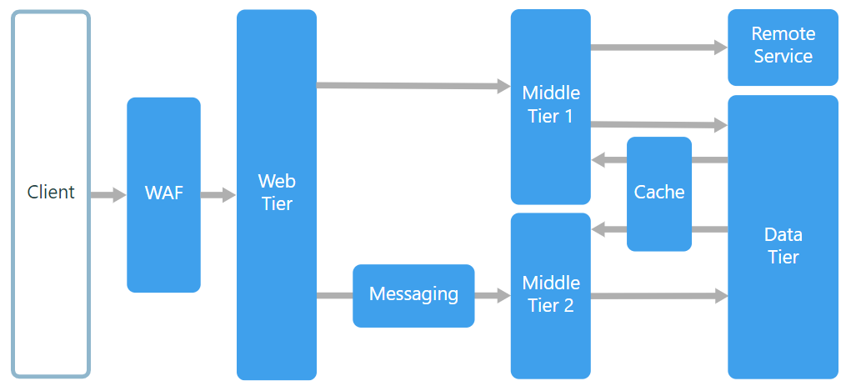
N-tier architecture divides an application into logical layers and physical tiers.

Slide 8
Benefits
Portability between cloud and on-premises, and between cloud platforms.
Less learning curve for most developers.
Natural evolution from the traditional application model.
Open to heterogeneous environment (Windows/Linux)

Slide 9
Challenges
It's easy to end up with a middle tier that just does CRUD operations on the database, adding extra latency without doing any useful work.
Monolithic design prevents independent deployment of features.
Managing an IaaS application is more work than an application that uses only managed services.
It can be difficult to manage network security in a large system.

Slide 10
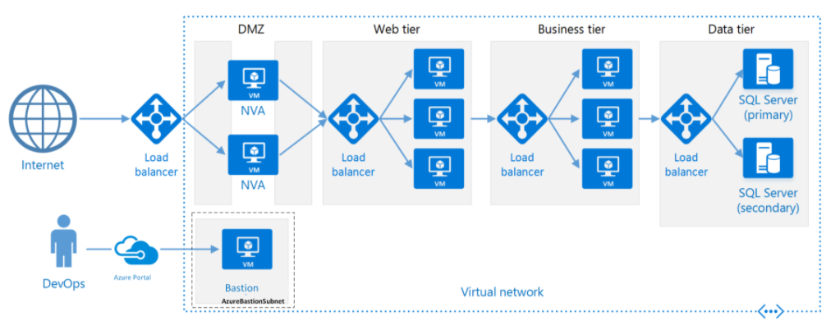
N-tier architecture running on Azure

Slide 11
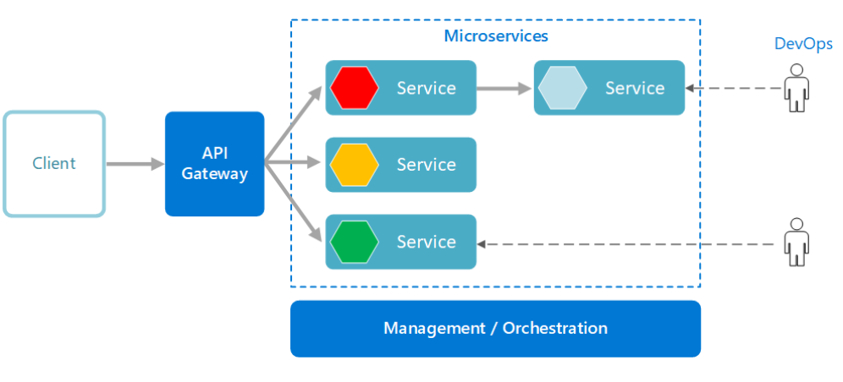
Microservices
A microservices architecture consists of a collection of small, autonomous services. Each service is self-contained and should implement a single business capability.

Slide 12
What are microservices?
Microservices are small, independent, and loosely coupled. A single small team of developers can write and maintain a service.
Each service is a separate codebase, which can be managed by a small development team.
Services can be deployed independently. A team can update an existing service without rebuilding and redeploying the entire application.

Slide 13
What are microservices?
Services are responsible for persisting their own data or external state. This differs from the traditional model, where a separate data layer handles data persistence.
Services communicate with each other by using well-defined APIs. Internal implementation details of each service are hidden from other services.
Supports polyglot programming. For example, services don't need to share the same technology stack, libraries, or frameworks.
Notes:
Besides for the services themselves, some other components appear in a typical microservices architecture:
Management/orchestration. This component is responsible for placing services on nodes, identifying failures, rebalancing services across nodes, and so forth. Typically this component is an off-the-shelf technology such as Kubernetes, rather than something custom built.
API Gateway. The API gateway is the entry point for clients. Instead of calling services directly, clients call the API gateway, which forwards the call to the appropriate services on the back end.

Slide 14
Benefits
Agility. Because microservices are deployed independently, it's easier to manage bug fixes and feature releases. You can update a service without redeploying the entire application, and roll back an update if something goes wrong.
Small, focused teams. A microservice should be small enough that a single feature team can build, test, and deploy it. Small team sizes promote greater agility.

Slide 15
Benefits
Small code base. In a monolithic application, there is a tendency over time for code dependencies to become tangled Adding a new feature requires touching code in a lot of places. By not sharing code or data stores, a microservices architecture minimizes dependencies, and that makes it easier to add new features.
Mix of technologies. Teams can pick the technology that best fits their service, using a mix of technology stacks as appropriate.

Slide 16
Benefits
Fault isolation. If an individual microservice becomes unavailable, it won't disrupt the entire application, as long as any upstream microservices are designed to handle faults correctly (for example, by implementing circuit breaking).
Scalability. Services can be scaled independently, letting you scale out subsystems that require more resources, without scaling out the entire application.
Data isolation. It is much easier to perform schema updates, because only a single microservice is affected.

Slide 17
Challenges
Complexity. A microservices application has more moving parts than the equivalent monolithic application. Each service is simpler, but the entire system as a whole is more complex.
Development and testing. Writing a small service that relies on other dependent services requires a different approach than a writing a traditional monolithic or layered application.
Lack of governance. The decentralized approach to building microservices has advantages, but it can also lead to problems. You may end up with so many different languages and frameworks that the application becomes hard to maintain.

Slide 18
Challenges
Network congestion and latency. The use of many small, granular services can result in more interservice communication. Also, if the chain of service dependencies gets too long (service A calls B, which calls C...), the additional latency can become a problem.
Data integrity. With each microservice responsible for its own data persistence. As a result, data consistency can be a challenge. Embrace eventual consistency where possible.
Management. To be successful with microservices requires a mature DevOps culture. Correlated logging across services can be challenging. Typically, logging must correlate multiple service calls for a single user operation.

Slide 19
Challenges
Versioning. Updates to a service must not break services that depend on it. Multiple services could be updated at any given time, so without careful design, you might have problems with backward or forward compatibility.
Skill set. Microservices are highly distributed systems. Carefully evaluate whether the team has the skills and experience to be successful.

Slide 20
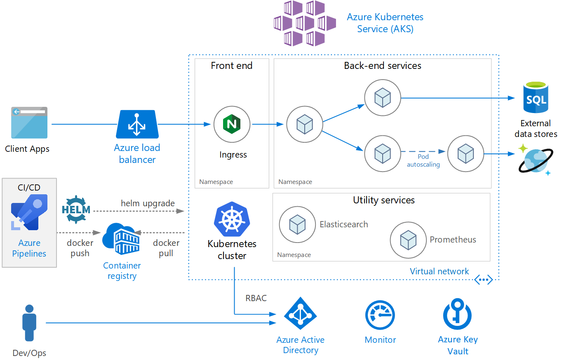
Microservices architecture on Azure

Slide 21
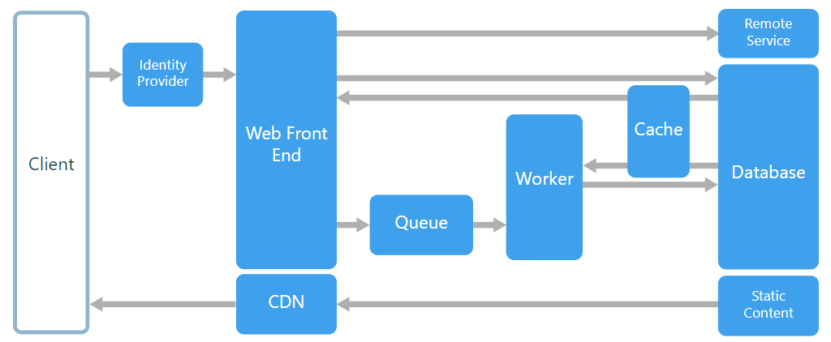
Web-Queue-Worker architecture style
The core components of this architecture are a web front end that serves client requests, and a worker that performs resource-intensive tasks, long-running workflows, or batch jobs. The web front end communicates with the worker through a message queue.
Notes:
Other components that are commonly incorporated into this architecture include:
One or more databases.
A cache to store values from the database for quick reads.
CDN to serve static content
Remote services, such as email or SMS service. Often these are provided by third parties.
Identity provider for authentication.

Slide 22
When to use this architecture
Applications with a relatively simple domain.
Applications with some long-running workflows or batch operations.
When you want to use managed services, rather than infrastructure as a service (IaaS).
Notes:
The Web-Queue-Worker architecture is typically implemented using managed compute services, either Azure App Service or Azure Cloud Services.
Consider this architecture style for:

Slide 23
Benefits
Relatively simple architecture that is easy to understand.
Easy to deploy and manage.
Clear separation of concerns.
The front end is decoupled from the worker using asynchronous messaging.
The front end and the worker can be scaled independently.

Slide 24
Challenges
Without careful design, the front end and the worker can become large, monolithic components that are difficult to maintain and update.
There may be hidden dependencies, if the front end and worker share data schemas or code modules.

Slide 25
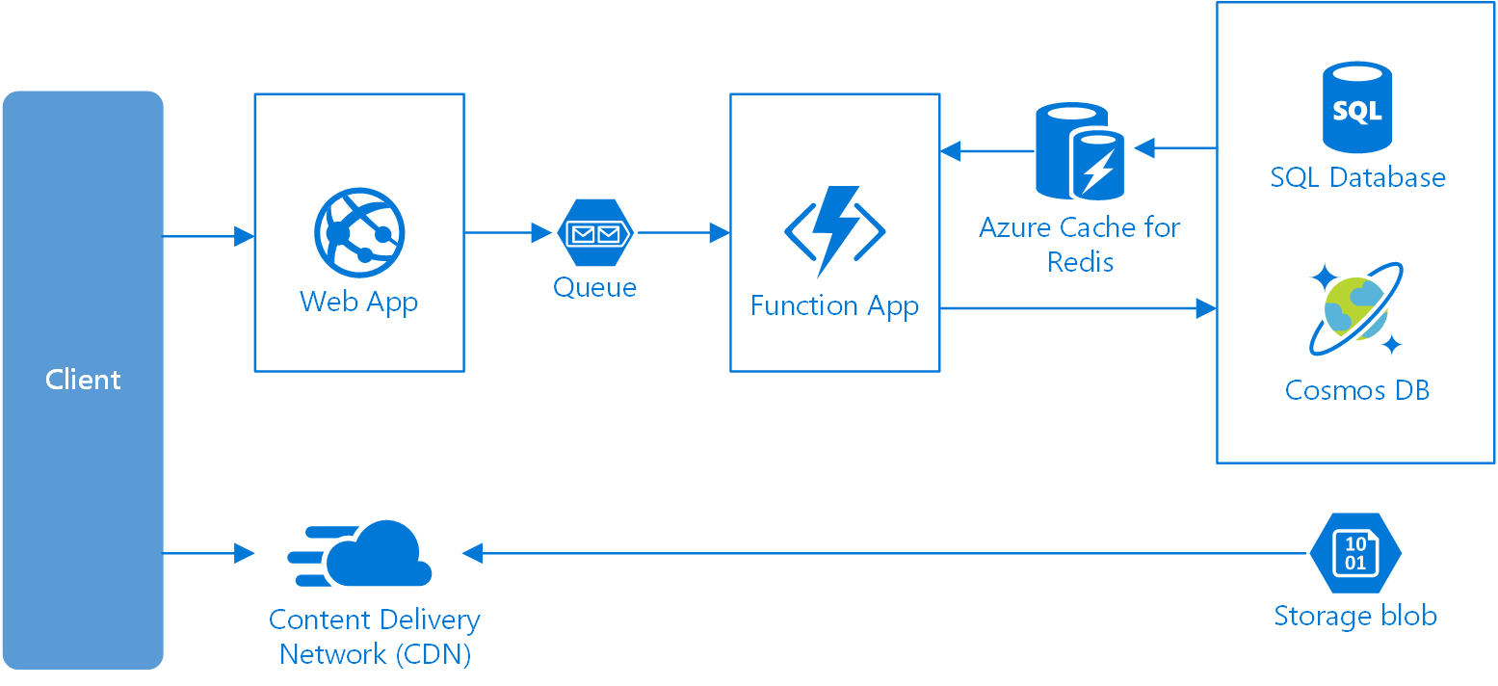
Web-Queue-Worker on Azure
Notes:
The front end is implemented as an Azure App Service web app, and the worker is implemented as an Azure Functions app. The web app and the function app are both associated with an App Service plan that provides the VM instances.
You can use either Azure Service Bus or Azure Storage queues for the message queue. (The diagram shows an Azure Storage queue.)
Azure Cache for Redis stores session state and other data that needs low latency access.
Azure CDN is used to cache static content such as images, CSS, or HTML.
For storage, choose the storage technologies that best fit the needs of the application. You might use multiple storage technologies (polyglot persistence). To illustrate this idea, the diagram shows Azure SQL Database and Azure Cosmos DB.

Slide 26
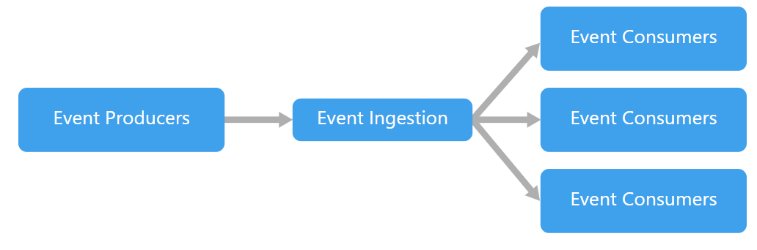
Event-driven architecture style
An event-driven architecture consists of event producers that generate a stream of events, and event consumers that listen for the events.

Slide 27
Event-driven architecture style
Pub/sub: The messaging infrastructure keeps track of subscriptions. When an event is published, it sends the event to each subscriber. After an event is received, it cannot be replayed, and new subscribers do not see the event.
Event streaming: Events are written to a log. Events are strictly ordered (within a partition) and durable. Clients don't subscribe to the stream, instead a client can read from any part of the stream. The client is responsible for advancing its position in the stream. That means a client can join at any time, and can replay events.

Slide 28
When to use this architecture
Multiple subsystems must process the same events.
Real-time processing with minimum time lag.
Complex event processing, such as pattern matching or aggregation over time windows.
High volume and high velocity of data, such as IoT.

Slide 29
Benefits
Producers and consumers are decoupled.
No point-to-point integrations. It's easy to add new consumers to the system.
Consumers can respond to events immediately as they arrive.
Highly scalable and distributed.
Subsystems have independent views of the event stream.

Slide 30
Challenges
Guaranteed delivery. In some systems, especially in IoT scenarios, it's crucial to guarantee that events are delivered.
Processing events in order or exactly once. Each consumer type typically runs in multiple instances, for resiliency and scalability. This can create a challenge if the events must be processed in order (within a consumer type), or if the processing logic is not idempotent.

Slide 31
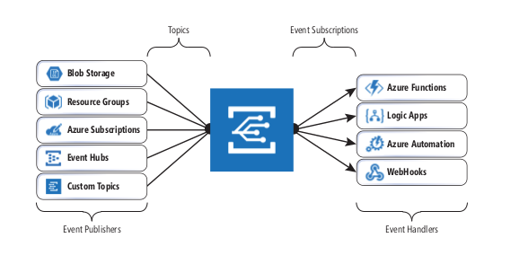
Event-driven architecture on Azure

Slide 32
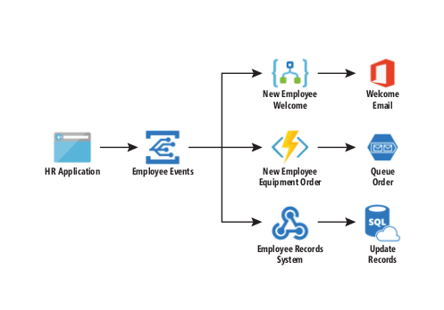
Event-driven architecture on Azure

Slide 33
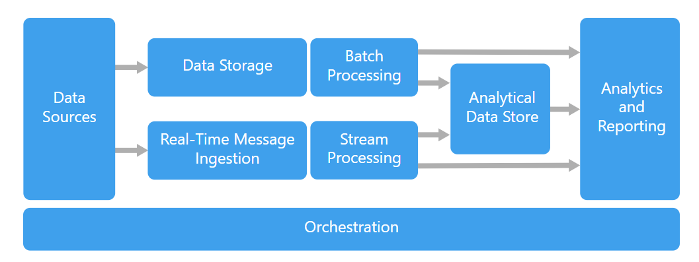
Big data architecture style
A big data architecture is designed to handle the ingestion, processing, and analysis of data that is too large or complex for traditional database systems.

Slide 34
Big data architecture style
Data sources: All big data solutions start with one or more data sources. Examples include:
Application data stores, such as relational databases.
Static files produced by applications, such as web server log files.
Real-time data sources, such as IoT devices.

Slide 35
Big data architecture style
Data storage: Data for batch processing operations is typically stored in a distributed file store that can hold high volumes of large files in various formats.
Batch processing: Because the data sets are so large, often a big data solution must process data files using long-running batch jobs to filter, aggregate, and otherwise prepare the data for analysis. Usually these jobs involve reading source files, processing them, and writing the output to new files.

Slide 36
Big data architecture style
Real-time message ingestion: If the solution includes real-time sources, the architecture must include a way to capture and store real-time messages for stream processing. This might be a simple data store, where incoming messages are dropped into a folder for processing.
Analytical data store: Many big data solutions prepare data for analysis and then serve the processed data in a structured format that can be queried using analytical tools.

Slide 37
Big data architecture style
Analysis and reporting: The goal of most big data solutions is to provide insights into the data through analysis and reporting. To empower users to analyze the data, the architecture may include a data modelling layer, such as a multidimensional OLAP cube or tabular data model in Azure Analysis Services.
Orchestration: Most big data solutions consist of repeated data processing operations, encapsulated in workflows, that transform source data, move data between multiple sources and sinks, load the processed data into an analytical data store, or push the results straight to a report or dashboard.
Notes:
Azure includes many services that can be used in a big data architecture. They fall roughly into two categories:
Managed services, including Azure Data Lake Store, Azure Data Lake Analytics, Azure Synapse Analytics, Azure Stream Analytics, Azure Event Hub, Azure IoT Hub, and Azure Data Factory.
Open source technologies based on the Apache Hadoop platform, including HDFS, HBase, Hive, Pig, Spark, Storm, Oozie, Sqoop, and Kafka. These technologies are available on Azure in the Azure HDInsight service.

Slide 38
When to use this architecture
Store and process data in volumes too large for a traditional database.
Transform unstructured data for analysis and reporting.
Capture, process, and analyze unbounded streams of data in real time, or with low latency.
Use Azure Machine Learning or Microsoft Cognitive Services.
Notes:
Azure includes many services that can be used in a big data architecture. They fall roughly into two categories:
Managed services, including Azure Data Lake Store, Azure Data Lake Analytics, Azure Synapse Analytics, Azure Stream Analytics, Azure Event Hub, Azure IoT Hub, and Azure Data Factory.
Open source technologies based on the Apache Hadoop platform, including HDFS, HBase, Hive, Pig, Spark, Storm, Oozie, Sqoop, and Kafka. These technologies are available on Azure in the Azure HDInsight service.

Slide 39
Benefits
Technology choices. You can mix and match Azure managed services and Apache technologies in HDInsight clusters, to capitalize on existing skills or technology investments.
Performance through parallelism. Big data solutions take advantage of parallelism, enabling high-performance solutions that scale to large volumes of data.

Slide 40
Benefits
Elastic scale. All of the components in the big data architecture support scale-out provisioning, so that you can adjust your solution to small or large workloads, and pay only for the resources that you use.
Interoperability with existing solutions. The components of the big data architecture are also used for IoT processing and enterprise BI solutions, enabling you to create an integrated solution across data workloads.

Slide 41
Challenges
Complexity. Big data solutions can be extremely complex, with numerous components to handle data ingestion from multiple data sources. It can be challenging to build, test, and troubleshoot big data processes.
Skillset. Many big data technologies are highly specialized, and use frameworks and languages that are not typical of more general application architectures.
Technology maturity. Many of the technologies used in big data are evolving. While core Hadoop technologies such as Hive and Pig have stabilized, emerging technologies such as Spark introduce extensive changes and enhancements with each new release.

Slide 42
Challenges
Security. Big data solutions usually rely on storing all static data in a centralized data lake. Securing access to this data can be challenging, especially when the data must be ingested and consumed by multiple applications and platforms.

Slide 43
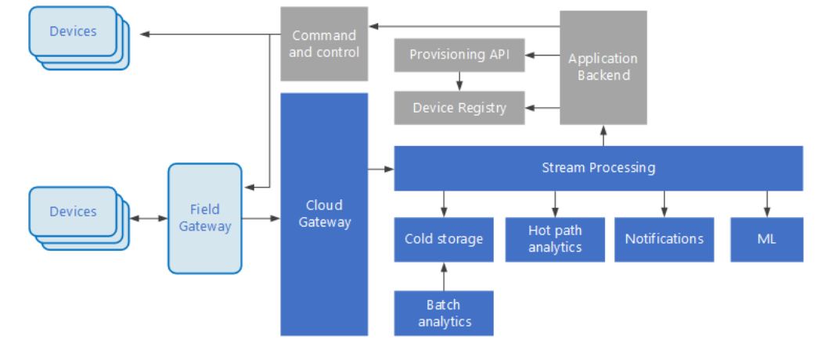
IoT architecture on Azure

Slide 44
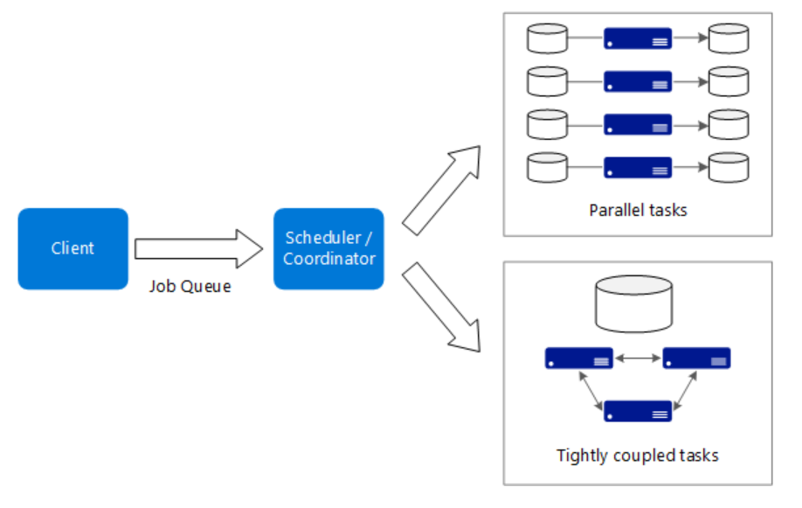
Big compute architecture style
The term big compute describes large-scale workloads that require a large number of cores, often numbering in the hundreds or thousands. Scenarios include image rendering, fluid dynamics, financial risk modeling, oil exploration, drug design, and engineering stress analysis, among others.

Slide 45
When to use this architecture
Computationally intensive operations such as simulation and number crunching.
Simulations that are computationally intensive and must be split across CPUs in multiple computers (10-1000s).
Simulations that require too much memory for one computer, and must be split across multiple computers.
Long-running computations that would take too long to complete on a single computer.
Smaller computations that must be run 100s or 1000s of times, such as Monte Carlo simulations.

Slide 46
Benefits
High performance with "embarrassingly parallel" processing.
Can harness hundreds or thousands of computer cores to solve large problems faster.
Access to specialized high-performance hardware, with dedicated high-speed InfiniBand networks.
You can provision VMs as needed to do work, and then tear them down.

Slide 47
Challenges
Managing the VM infrastructure.
Managing the volume of number crunching
Provisioning thousands of cores in a timely manner.
For tightly coupled tasks, adding more cores can have diminishing returns. You may need to experiment to find the optimum number of cores.

Slide 48
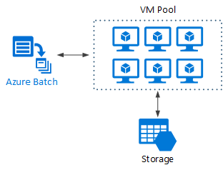
Big compute using Azure Batch

Slide 49
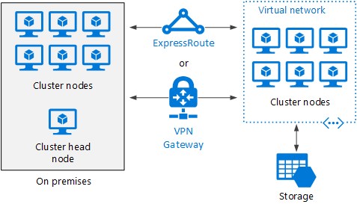
Burst an HPC cluster to Azure

Slide 50
Architecture styles as constraints
A service represents a single responsibility.
Every service is independent of the others.
Data is private to the service that owns it. Services do not share data.
Notes:
By adhering to these constraints, what emerges is a system where services can be deployed independently, faults are isolated, frequent updates are possible, and it's easy to introduce new technologies into the application.

